Slide 1
Java FileWriter class
myfile.txt
Java Application
Write
Java FileWriter class is used to write data to text files.
FileWriter is meant for writing streams of characters. For writing streams of raw bytes, consider using a FileOutputStream.

Slide 2
Writer
OutputStreamWriter
FileWriter

Slide 3
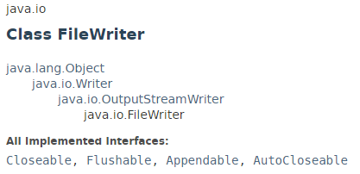
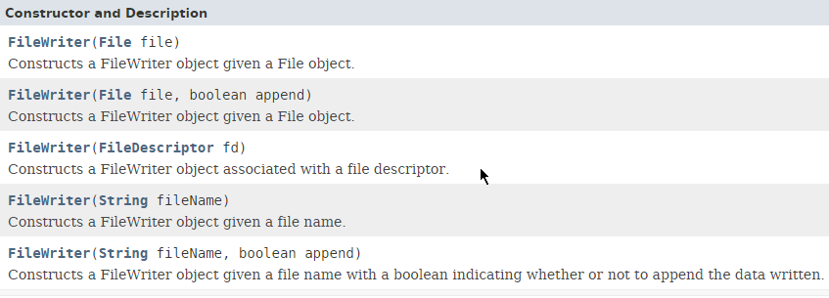
Java FileWriter class

Slide 4

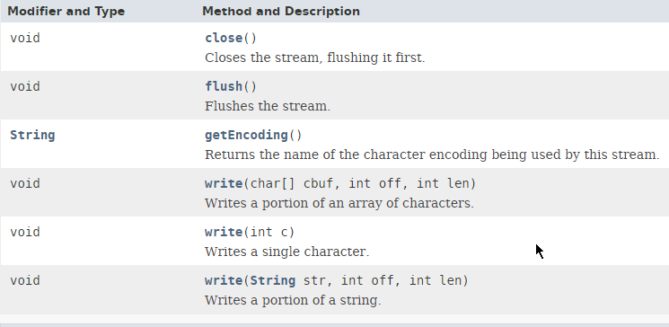
Java FileWriter class

Slide 5

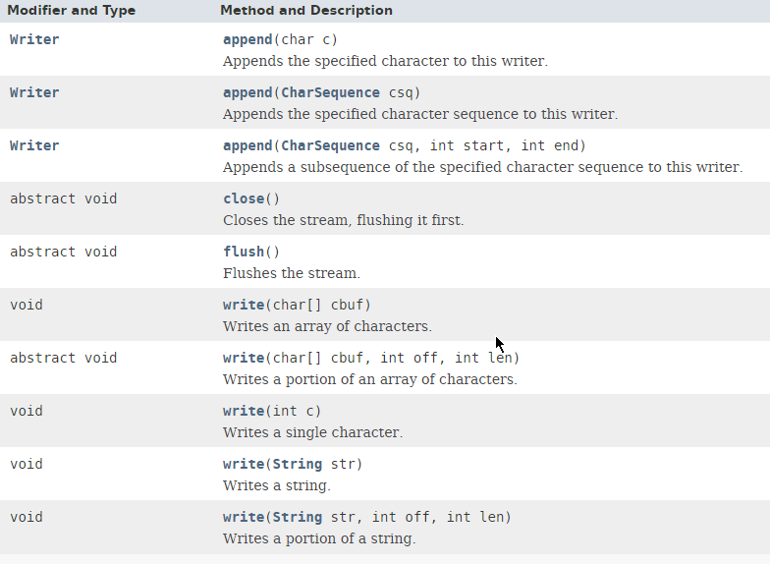
Java FileWriter class

Slide 6
Java FileWriter class
https://docs.oracle.com/javase/8/docs/api/java/io/FileWriter.html

